Slide 1

Bridging Humanities
Towards a special issue
Digital Humanities – The perspective of Africa
timeline
history
sessions
issue
focus
about
Mirjam de Bruijn, Kim de Vries & Sjoerd Sijsma

Slide 2
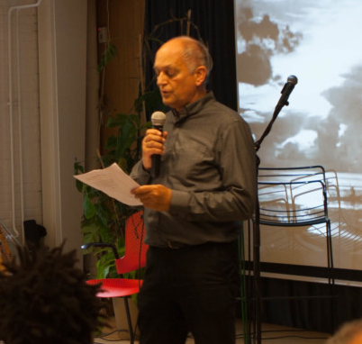
timeline
issue
history
sessions
focus
about
#humanitiesmatter
Joed Elich, BRILL PUBLISHERS
The digital space allows for new interactions and knowledge production through digital devices, that offers new possibilities for doing research and connecting to other knowledge users and producers. The academic publishing community must keep up with these changes and explore these new possibilities.

Slide 3



2016
2017
2019
1
2
3
timeline
Voice4Thought
Brill Publishers
LEIDENASA
history
sessions
issue
focus
about
Started experimenting with e-publishing
Partnership & academic acknowledgement
Two publications: Croquemort & Dissenting Voices

Slide 4
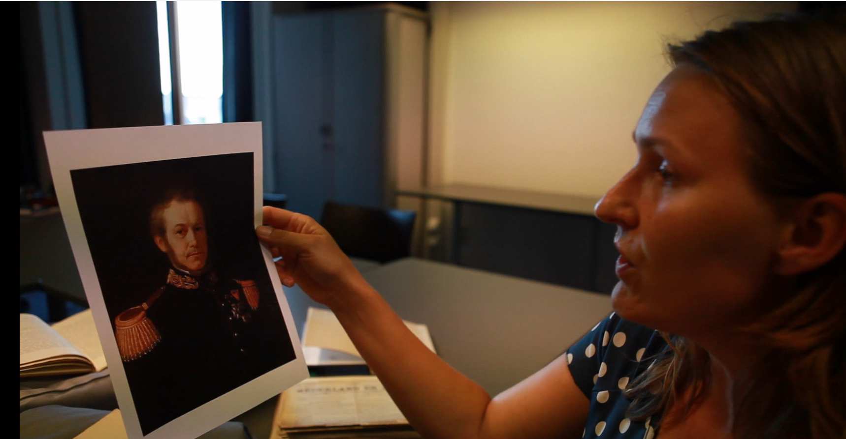
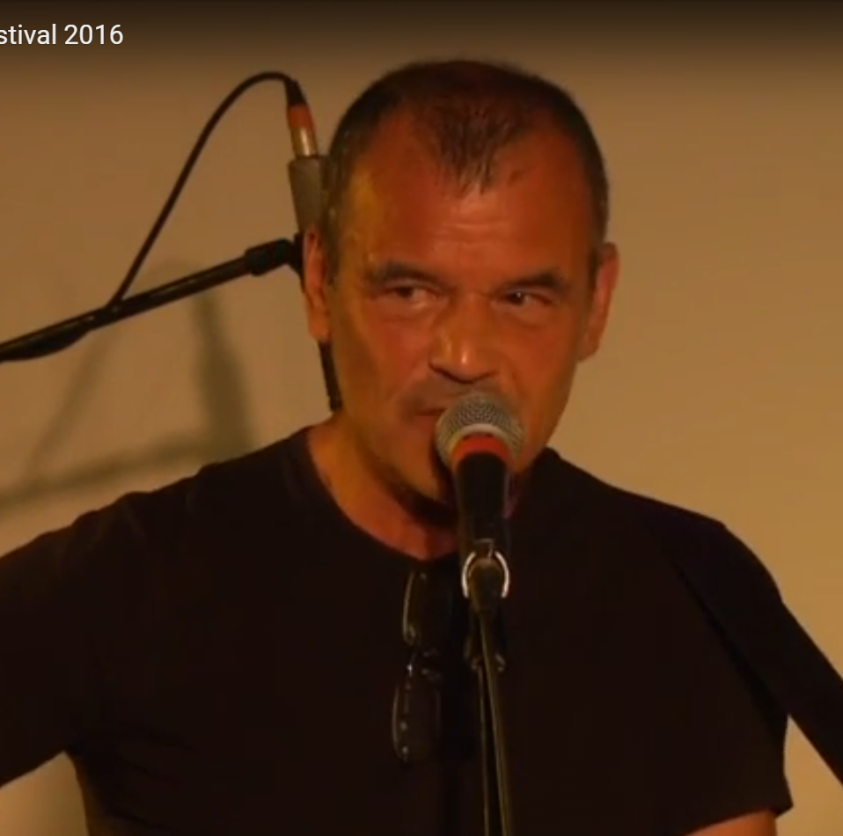
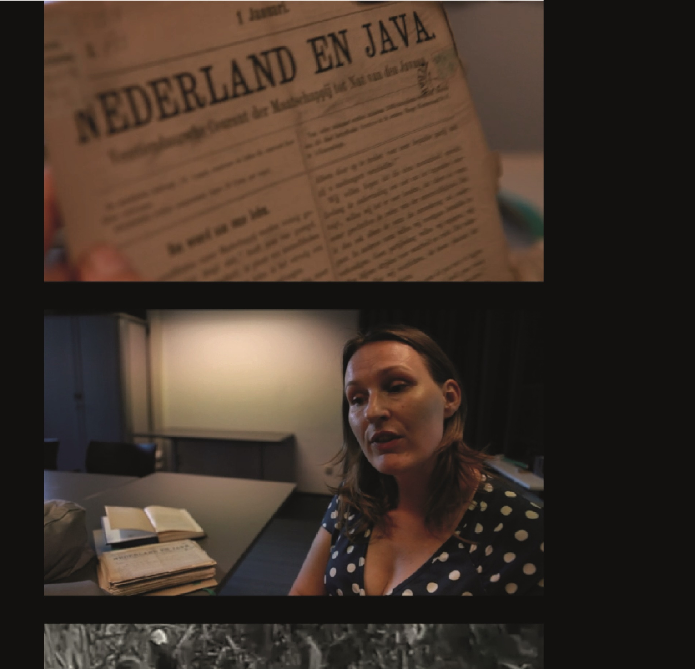
Develop digital methodologies for
01
02
03
timeline
history
sessions
teams
focus
about
Reflection
Co-creation
Archiving
  Share critical reflections on academic knowledge from the Humanities.
  Elaborate an interactive methodology of creating and sharing knowledge
Build enhanced publications that link arguments to an archive that represents the research and publication process.

Slide 5




Towards a layered publication
The goal of the creative sessions is to articulate joint work and/or reflections of the participants on overarching issues that shape the DH field in Africa, in the form of enhanced publications. We will work towards a peer reviewed publication.
A co-working webspace (Wordpress) is provided, in which participants can present their statements and refer to different kind of source material, so that insight is gained in how knowledge has been produced. We will facilitate interaction.
The Bridging Humanities special issue will form an archive that presents the ‘Voice of Africa in DH’, specifying how the field is developing on the continent, with a focus on the innovations as well as the needs that arise from the specific context.
The papers should reflect on the collaborative process in which authors/makers from various backgrounds have come to their insights. Participants may be interviewed on film for this, and this material can be added to the enhanced publications.
timeline
history
sessions
issue
focus
about

Slide 6
Days
Shared project work sessions
This afternoon articulation of topics, all ideas are welcome!
1-5
Day
3
Stef Scagliola: Enhanced publications
timeline
sessions
history
issue
focus
about
Day
4
Creative session
Day
Final feedback round
5

Slide 7
timeline
history
sessions
issue
focus
about
9-12 July
DH2019
1 October 2019
November 2019
30 January 2020
DRAFT PAPERS READY, POSTER PRESENTATION,
FILM SCREENING
PAPERS READY FOR SUBMISSION
PEER REVIEW
PROCESS
ISSUE PRESENTED
@ LEIDENASA CONFERENCE
+ Synthesis by selected group
Comments of the peer reviewers are to be responded to
Possible follow-up ‘phase 2’ towards Final LeidenASA conference December 2020
Possible continued joint work

