Slide 1
Digital Humanities –
The Perspective of Africa
1-5 July 2019
Lorentz Center, Leiden

Slide 2

ToC
Goals and objectives
Organisation and support
Preparatory steps
Practicalities
Survey information

Slide 3
Goals/objectives Lorentz DH-workshop
Articulate the contribution of scholars from the African continent to the domain of Digital Humanities and make it visible to the wider DH community at DH2019 (biggest DH-event ever) and ADHO at large.
Set up and strengthen collaborative links through
  Exchange of information and expertise
  Exchange of research agendas
  Joint work
Capacity development with a focus on
  Skills demanded by the Open Science agenda
  Data management and data processing
  Enhance technical skills
  Service offer from research infrastructures
  Publication of research results
Reflective discussions on digital scholarship

Slide 4
Goals/objectives Lorentz DH-workshop
Joint project ideas / Joint project work
Joint notes from the workshop (Etherpad)
Presentations during dedicated poster session at DH2019 (10 July)
Mini-documentary
Outlines / first drafts of papers that can be selected for special issue of Bridging Humanities (publisher: Brill)
Insight in existing platforms for the support of DH
Insight in added value of collaboration emerging from the workshop and roadmap towards next level

Slide 5
Organisation and support
Lorentz center
Infrastructural initiatives
Sponsors
Speakers & observers
Organisers

Slide 6
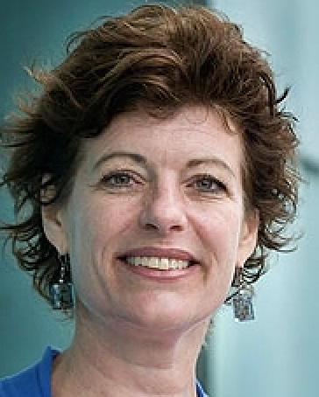
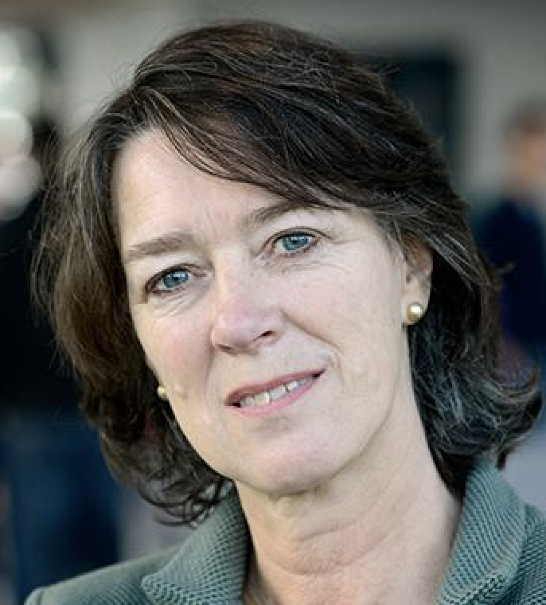
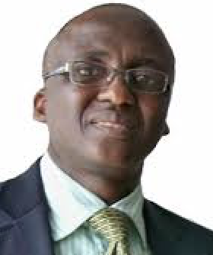
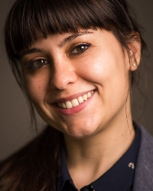
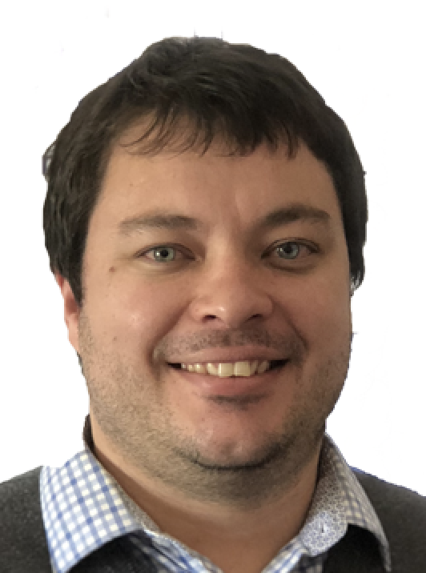
Organisers
Mirjam de Bruijn (Leiden University NL)
Franciska de Jong (Utrecht University NL / CLARIN ERIC)
Tunde Opeibi (University of Lagos, Nigeria)
Sara Petrollino (Leiden University NL / CLARIN ERIC)
Juan Steyn ( , South Africa)

Slide 7
Preparatory steps
Overview of DH initiatives in Africa (2017)
Workshop proposal accepted by Lorentz (Spring 2018)
Endorsement by ADHO of Africa as theme (September 2018)
Website online (November 2018)
Call for applications (December 2018)
Selection of participants (March 2019)
Requests for profiles and survey (April-May 2019)
Moodle input (May 2019)

Slide 8
Practicalities
Utrecht
DH2019 practicalities: after take off
Sign up for DH2019 workshops (some are still not fully booked)
Leiden
Rent a bike
… (more to follow)

Slide 9
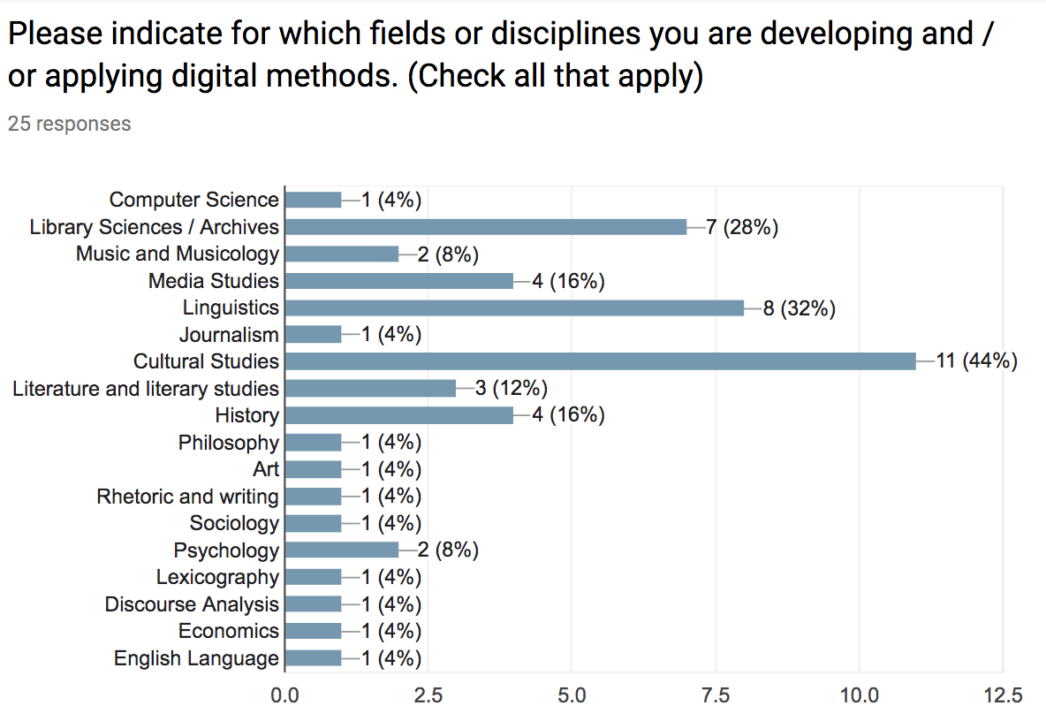
Survey results 1

Slide 10
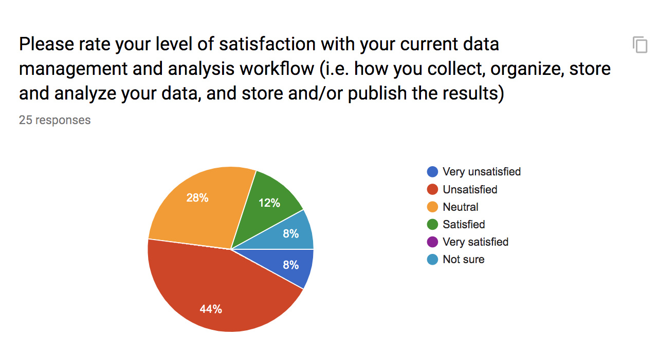
Survey results 2

Slide 11
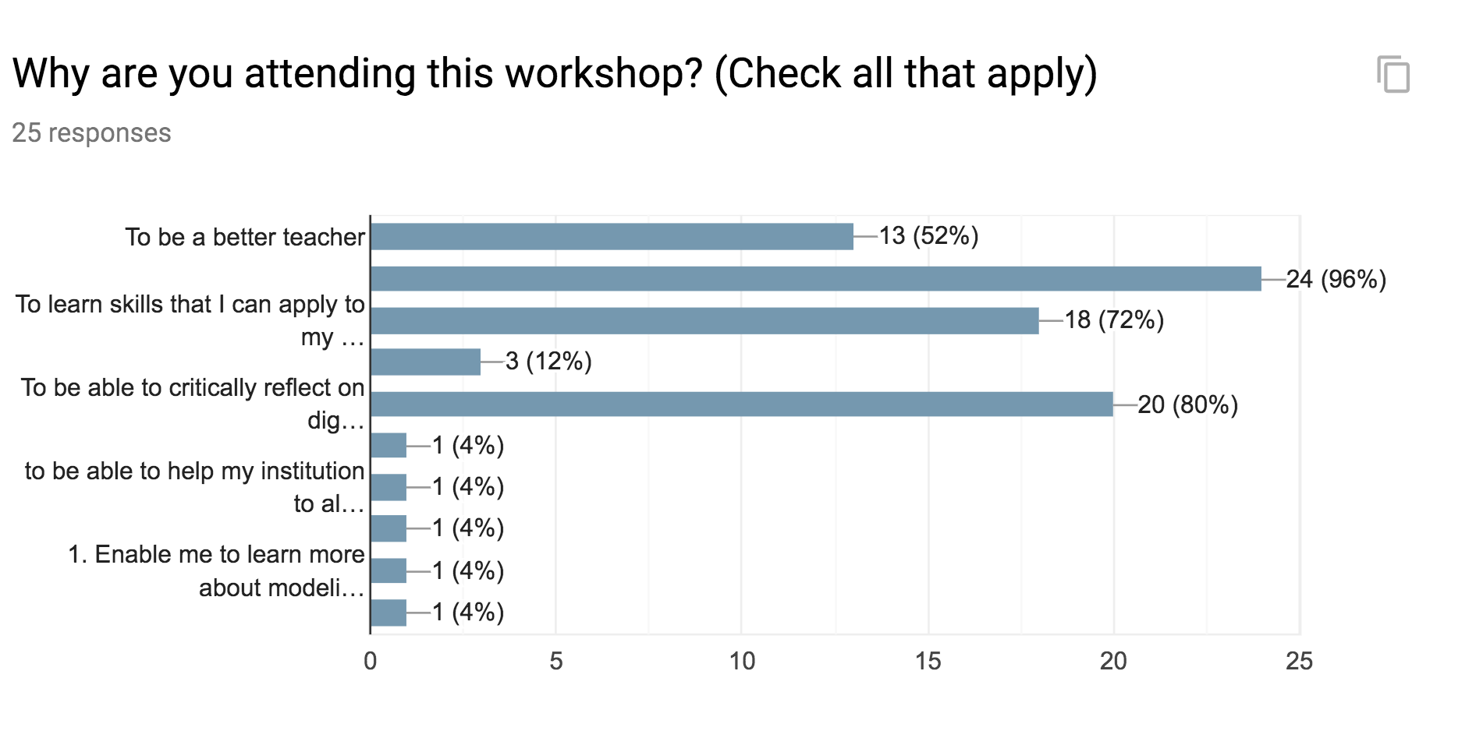
Survey results 3

