Slide 1


Finding, using and contributing research data through Research Infrastructures:
The case of Parliamentary Data
Darja Fišer
#LorentzWorkshop
Leiden, 1 July 2019
CC-BY 4.0

Slide 2
Intro to CLARIN https://www.clarin.eu

Slide 3
CLARIN in five bullets
CLARIN is the Common Language Resources and Technology Infrastructure
that provides easy and sustainable access for scholars in the humanities and social sciences
to digital language data in written, spoken, video or multimodal form
and advanced tools to discover, explore, exploit, annotate, analyse or combine them, wherever they are located
through a single sign-on online environment

Slide 4
CLARIN data types and user communities
Newspaper archives
Literary texts
Parliamentary records
Literary texts
Historical letters
Broadcast archives
Oral History data
Social Media data
L-2 Learner Resources
Digital humanities
Linguistics and Philology
Translation and Lexicography
Literary Studies
History
Political and Social Sciences
Media Studies
Culture, Folklore, Anthropology
Speech therapy
Teachers
General Public

Slide 5
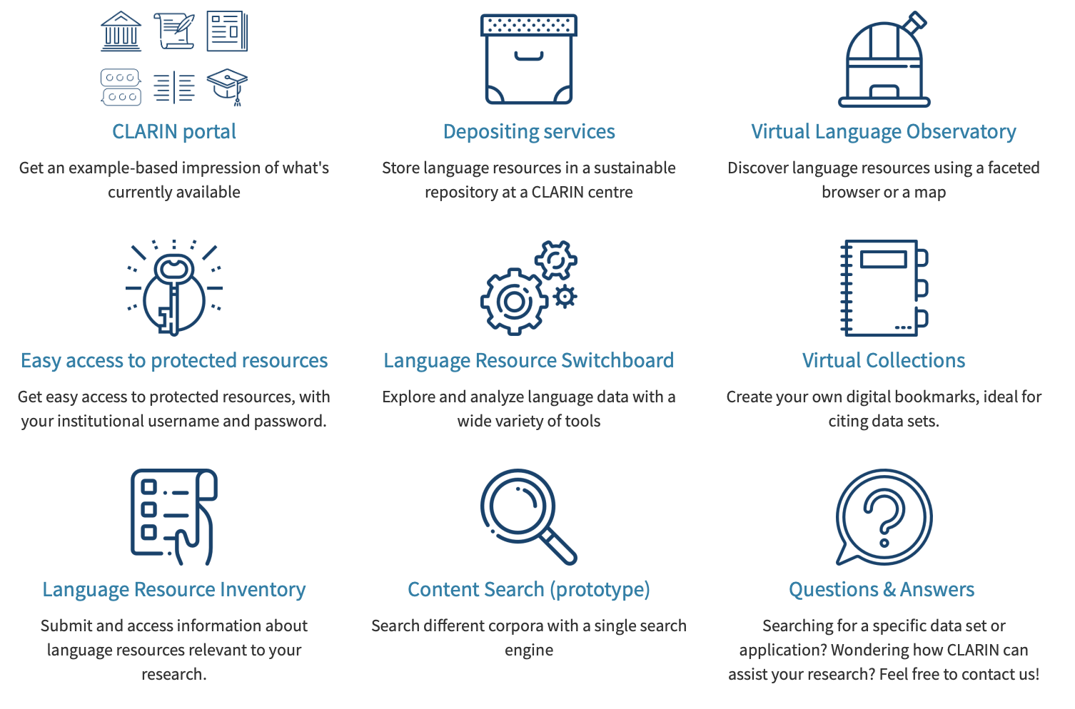
CLARIN services

Slide 6
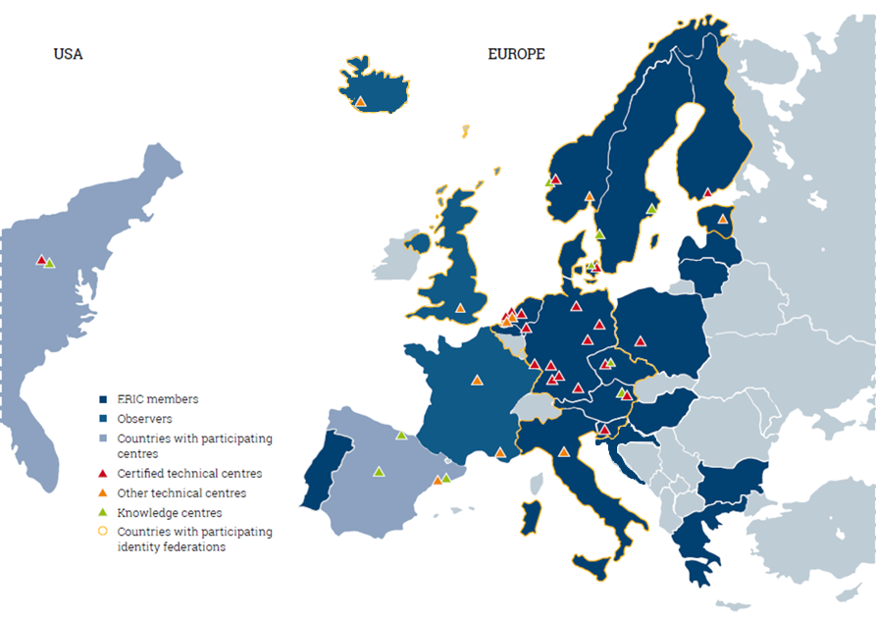
CLARIN members and centres
A consortium of:
21 members: AT, BG, CY, CZ, DE, DK, DLU, EE, FI, GR, HR, HU, IT, LT, LV, NL, NO, PL, PT, SE, SI
4 observers:
FR, UK, IS, SA
>50 centres

Slide 7
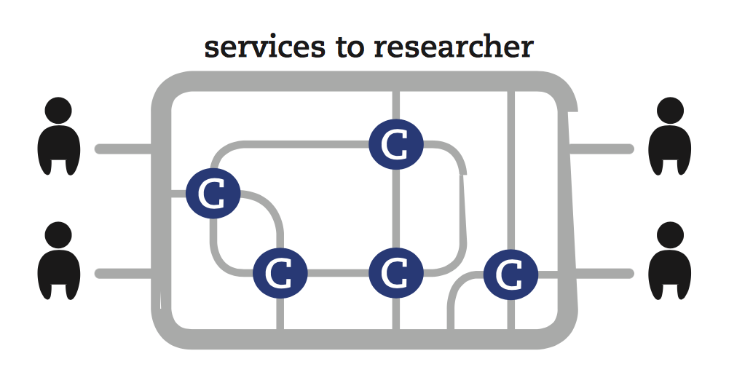
What CLARIN Centres offer
Repository
  library of linguistic data and tools
  search for data and tools and easily use them online or download them
  deposit your data and be sure it is safely stored, everyone can find it, and correctly cite it
Federated single sign-on
  log in once with your existing institutional credentials
  get access to protected resources
Metadata
  describe content, provenance and formats of linguistic data and tools
  facilitate preservation and dissemination of linguistic data and tools
Persistent Identifier (PID or handle)
  a special permanent URL that provides a permanent link to linguistic data and tools
  will resolve correctly even if in some distant future the data is moved
  should be used as URL in citations
Licensing
  Public
  Academic
  Restricted
  Preservation (Data Seal of Approval)
  committed to long-term care of items in the repository
  ensure the archived data can be found, understood and used in the future

Slide 8
PARTHENOS https://training.parthenos-project.eu

Slide 9
Background & Motivation
from data scarcity to data flooding
  robust, verifiable and reproducible quantitative, automated approaches, techniques and methods to process, visualize and combine research data
  research on a much larger scale, sparking entirely novel research questions
the new resources, tools and techniques need to be well understood
  data formatting, corpus encoding and corpus annotation for different types of specialized discourse
  research data and metadata harvested from the source vs. their enrichments obtained from DH tools
  corpus querying, visualization and interpretation to tackle research questions in the same dataset from a broad range of research disciplines
goals of my talk
  raise awareness of the societal, institutional and technological circumstances that shape the content, structure and language of a particular type of specialized discourse
  highlight the importance, potential, peculiarities and implications that these factors have for research in DH
target audience of my talk
  Digital Humanities or Cultural Heritage researcher/practitioner
  Computer Scientists researcher or Data Steward

Slide 10
Parliamentary proceedings in the Digital Age
The parliament
  old
    the most important political institution in a democratic society
    journalists, members of the civil society, and humanities and social sciences scholars pay close attention to parliamentary debates
  new
    increasingly decisive role
    changing institutional relations with the public, the mass media, the executive branch and international organizations
Parliamentary proceedings
  Freedom of Information Act: free and transparent access
  benefits
    informed participation by the public
    improves effective functioning of democratic systems
    makes the datasets more readily available for researchers with heterogeneous backgrounds, including diachronic and transnational comparative analyses

Slide 11
Parliamentary debates for cross-disciplinary research
Parliamentary discourse
  governed by strict rules and conventions
    specific institutional discursive features
  motivated by a range of communicative goals & ideology / party line
    role-based commitments and confrontations
    constant awareness of a multi-layered audience
Parliamentary records
  unique content, structure and language, records
  important resource for a wide range of research questions from many disciplines
    political science, communication studies, history, sociolinguistics, multilinguality
Interdisciplinary scope very new
  technological and methodological developments enabled cross-fertilization of disciplines
  text mining, social network analysis, geospatial analysis, data visualization >> structure, search, mine, manipulate, visualize, share, and combine parliamentary data
  apply interpretative traditions of the humanities and social sciences to data on a very large scale
  allow them to address new research questions and develop novel techniques for tackling complex social phenomena (migrant crisis, Euroscepticism, populist movements)
  more comprehensive exploration of various socio-political research questions
Empirical research and development of integrative analytical tools needed
  a better understanding of commonalities and specificities of parliamentary discourse
  its wider societal impact, in particular with studies of diverse parts of society (women, minorities, marginalized groups) and cross-cultural studies

Slide 12
Parliamentary proceedings as a research dataset
key characteristics
  essentially transcriptions of spoken language produced in highly controlled and regulated settings
  rich in invaluable (sociodemographic) metadata
  rich in links to other research data (e.g. legislation)
key requirements
  easily findable and accessible
  encoded according to international standards / recommendations
  equipped with rich and reliable annotations and metadata

Slide 13
Typical workflow in digital humanities research with parliamentary data
issues
  Corpus development efforts not well co-ordinated
  Corpora not uniformly sampled, annotated, formatted or documented
goals
  Promote comparability and reproducibility of research results
  Foster interdisciplinary, trans-national and cross-cultural studies
  Discuss how they could be made more readily available to the heterogeneous research community

Slide 14
Encoding of parliamentary data
format, quality and structure of the source files are essential
traditionally, only transcriptions of parliamentary sessions have been made available
now being increasingly released in audio and video as well
key encoding issues in the encoding of parliamentary data
  Source files
  Structural elements
  Encoding standards
  Metadata
  Linguistic annotations
  Text enrichment

Slide 15
1. Source files
transcriptions of parliamentary proceedings are typically made available in HTML or PDF formats
appropriate for reading by humans but not for direct processing by computers >> need to be converted to XML

Slide 17
2. Structural elements
published in a stable uniform format
  table of contents
  list of speakers
  index of topics
  annexes (e.g. session papers, legislation)
  transcribed speeches,
    accompanied by non-verbal content (e.g. information about the meeting and the chairperson)
    description of the outcome of a vote
    description of actions (e.g. applause)

Slide 18
3. Encoding standards
Political Mashup
Parliamentary Metadata Language
Akomo Ntoso schema
Text Encoding Initiative Guidelines

Slide 19
4. Metadata
parliamentary records are rich in extralinguistic markup
  on the speech level
    parliamentary session
    date
    meeting item
    speaking time
  on the speaker level
    speaker’s name
    date of birth
    gender, education
    party affiliation)
can be used as variables in analysis or for fine-grained filtering of the research data
Text production in the German parliament over time by political party

Slide 20
Most characteristic nouns specific to a given parliamentary group in the French parliament.
Representation and text production of female members of the Danish parliament

Slide 21
5. Linguistic annotations
parliamentary records are further enriched with different levels of linguistic annotations
  tokenization (identifying words and, typically, punctuation marks)
  sentence segmentation (marking sentence boundaries)
  morphosyntactic tagging (adding information on the part of speech and other morphosyntactic characteristics of each word token in the corpus)
  lemmatization (providing the base dictionary forms of the inflected words)

Slide 22
6. Text enrichment
to further facilitate the use of parliamentary records, they often also include
  annotations of named entities (markings of names of persons, organizations and places)
  sentiment (information on whether a speech conveys a positive, negative or neutral attitude about the subject matter)
  discussion topics
  linking with their corresponding Wikipedia pages (e.g. Brexit)
  linking of parliamentary debates with external knowledge sources (e.g. voting records)
Illustration of named entity recognition and linking in the UK parliamentary proceedings

Slide 23
Examples of sentiment annotation (positive in green, negative in red) in the UK parliamentary corpus

Slide 24
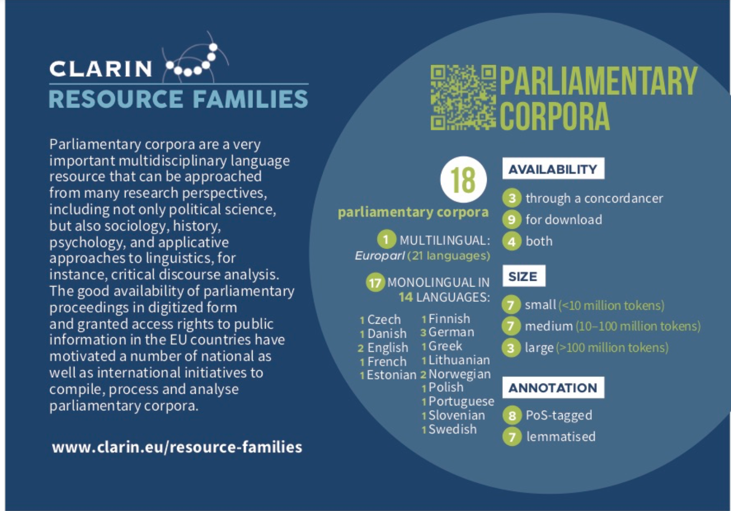
Parliamentary corpora in CLARIN Resource Families
18 parliamentary corpora
  15 national parliaments in 14 languages
  the corpus of the European parliament proceedings in 21 languages
  most are richly linguistically annotated
access
  directly downloaded
  queried through easy-to-use online search environments
  available under open licences
characteristics
  UK’s Hansard Corpus the largest (1.6 billion tokens, 7.6 million speeches made by around 40,000 different speakers) and spanning the longest time period (1803-2005)
  corpora from other countries are significantly smaller (10 - 100 million tokens) and cover shorter periods (mostly from the 1970s onwards)

Slide 25
Using parliamentary corpora in CLARIN

Slide 27
Case study 1: the War in Parliament project
data curation project
  made proceedings of the Dutch parliament available as a semi-structured corpus compliant with CLARIN standards
  corpus accessible through PoliticalMashup
  advanced search engine tailored to historical and social science research
  illustrative case study that showed how a corpus-based approach to the analysis of parliamentary proceedings unveiled certain aspects of the political past that had before remained only as vaguely remembered events in a nation’s collective memory
Piersma et al. (2012): systematically check how the Dutch Boerenpartij (Farmers’ Party) was associated with National Socialism between the years 1958 and 1982
  the Boerenpartij was implicitly criticised for their right-wing political stance throughout this entire period
  BUT: actually only once directly accused of fostering National Socialist ideas, and this was when Hendrik Adams, a member of the party, was singled out for being a supporter of the German occupier during World War II

Slide 28
Case study 2: Gender in the Danish parliament
Hansen et al. (2018) investigated gender differences in the revised transcripts of speeches from the Danish Parliament 2009-2017
  active participation of women in politics is historically relatively new and women are still underrepresented in the Danish parliament
  analysis:
    number of the speakers, their age, party and role in the party
    speech frequencies & speech lengths
    topics addressed
  results:
    general
      there were relatively more male spokespersons than female ones in the period covered by the corpus but the number of female MPs under 29 is larger than the number of male MPs from the same age group
      in general, women speak less frequently and for a shorter time than male MPs in proportion to their seats in Parliament, the difference in speaking time between female and male MPs is statistically significant
    role
      women belonging to left-wing parties speak less frequently than women from right-wing parties compared to their seats in Parliament
      female ministers and spokespersons speak more frequently than ordinary MPs
      female ministers under a male prime minister give fewer speeches than female ministers under a female prime minister even though their percentages in the two periods are similar
    topics
      female MPs more often spoke about “softer” political areas, while in the speeches of male MPs “harder” subjects prevailed

Slide 29
Case study 3: The Linked Open Data of Talk of Europe
data curation project
  turned the multilingual proceedings of the European Parliament into a highly interactive and structured parliamentary corpus
  enriched with Linked Open Data
    linked to encyclopedia to provide information about the Members of Parliament
    linked to a geographical knowledge base for European countries
  corpus is accessible through an online search interface that enables SPARQL query language
  ideal dataset for tackling various research questions where the gap between qualitative and quantitative approaches to parliamentary analysis needs to be bridged
Kessels et al. (2014)
  network analysis to explore highly complex constellations of relations between members of the EU parliament based on their interactions in plenary debates
Mandravickaite et al. (2015)
  stylometric analysis of the speeches of the EU members of parliament to uncover how the rhetoric of the members of the EP is similar / different to the rhetoric of the party groups they belong to and vs. of the other party groups

Slide 30
Veni, vidi, CLARIN!
Working with parliamentary records: https://www.clarin.eu/event/2017/clarin-plus-workshop-working-parliamentary-records
ParlaCLARIN @ LREC: https://www.clarin.eu/ParlaCLARIN
ParlaFormat: https://www.clarin.eu/event/2019/parlaformat-workshop
darja.fiser@ff.uni-lj.si

